Slide 1
Install Tensor Flow
Noble Xavier

Slide 2
INSTALL TENSOR FLOW

Slide 3
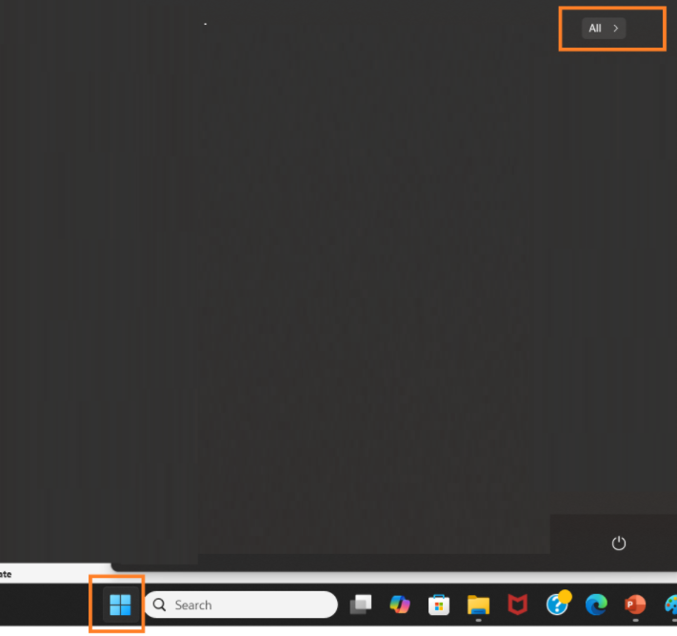
Install TensorFlow
Open Anaconda Navigator
Start -> All

Slide 4
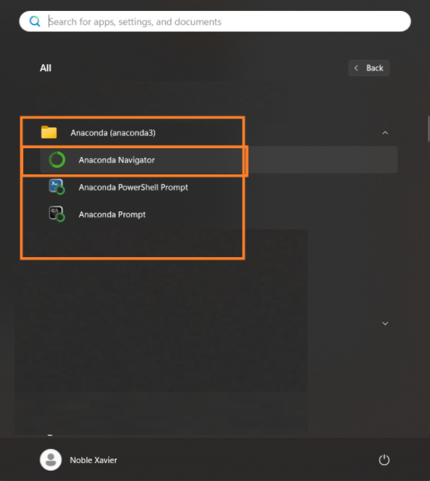
Install TensorFlow
Open Anaconda Navigator
Go to the folder
Anaconda (anaconda3) ->
Then click
Anaconda Navigator

Slide 5
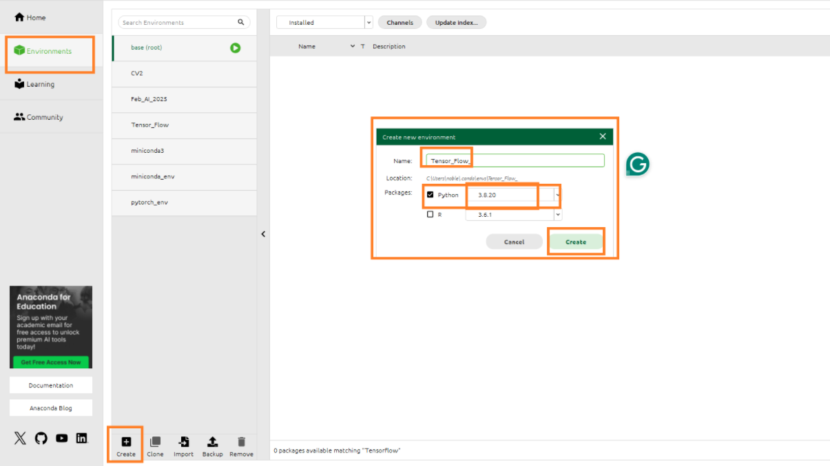
Install TensorFlow
Create a new Environment for TensorFlow
New Environment Name: Tensor_Flow
Click Environments -> Create -> <<Enter Environment Name >> ->
Choose Python Version 3.8.20-> Create

Slide 6
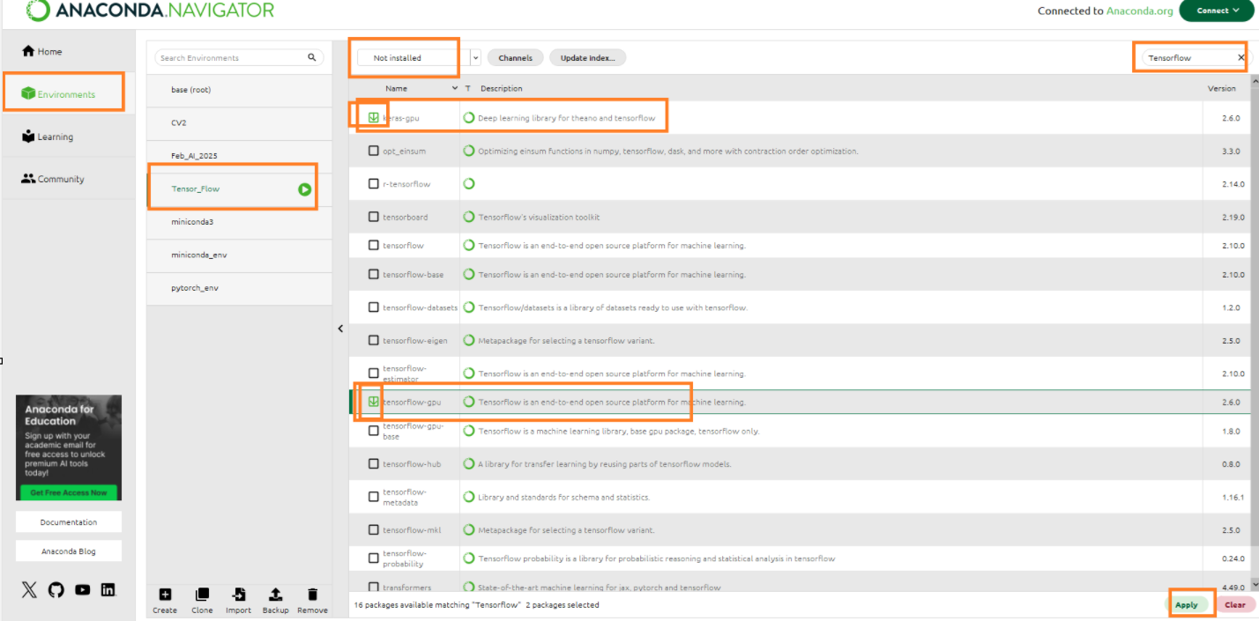
Install TensorFlow and Keras
After creating the new environment
Click Environment on the left side.
Click on the new environment created, expand it
Select Not Installed from the drop-down list
Search Tensorflow
Select keras-gpu and tensorflow-gpu
Click Apply

Slide 7
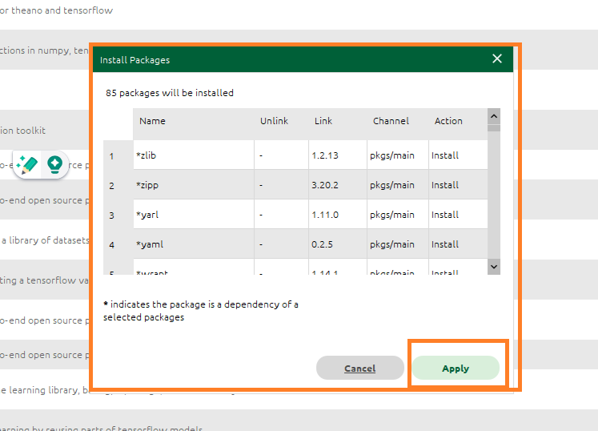
Install TensorFlow and Keras
Click Apply to install all keras and tensorflow related packages

Slide 8
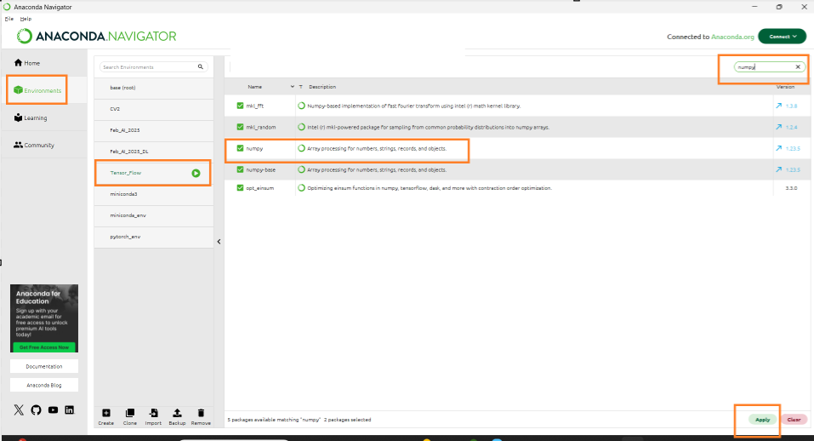
Install Common Libraries -NumPy
Under Not Installed search NumPy
Select NumPy from the list click Apply

Slide 9
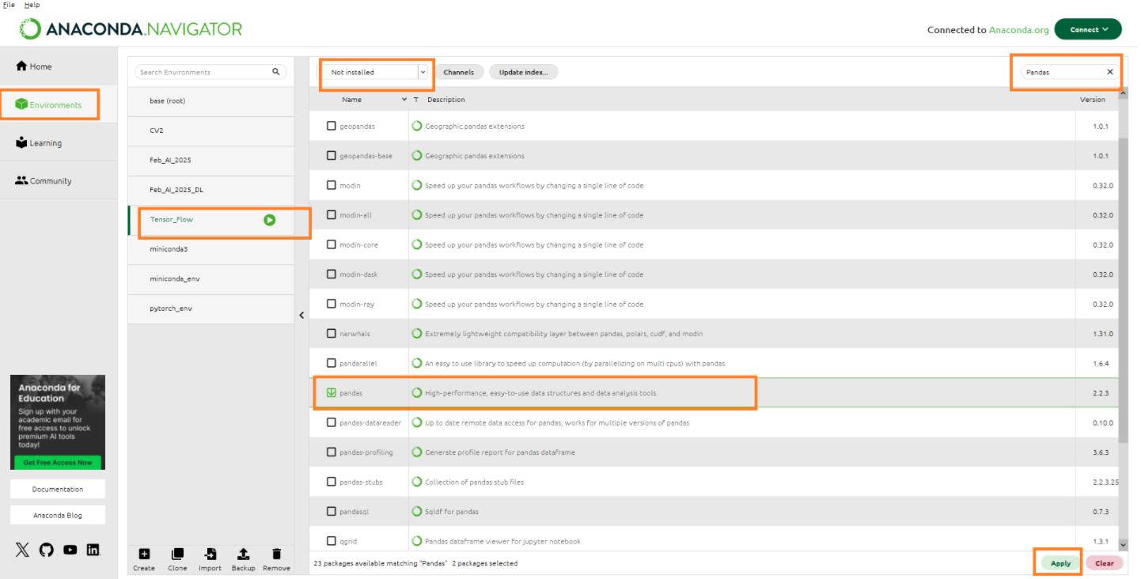
Install Common Libraries -Pandas
Under Not Installed search Pandas
Select Pandas from the list click Apply

Slide 10
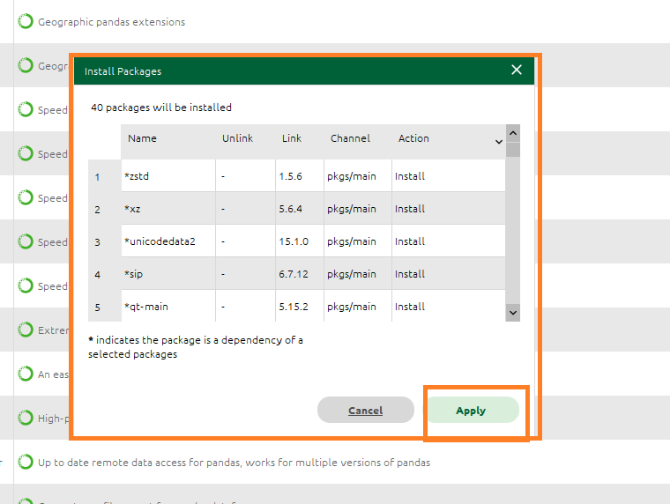
Install Common Libraries -Pandas
Click Apply to install all packages

Slide 11
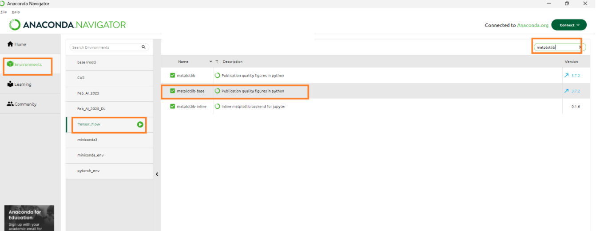
Install Common Libraries -Matplotlib
Under Not Installed search Matplotlib
Select Matplotlib from the list click Apply

Slide 12
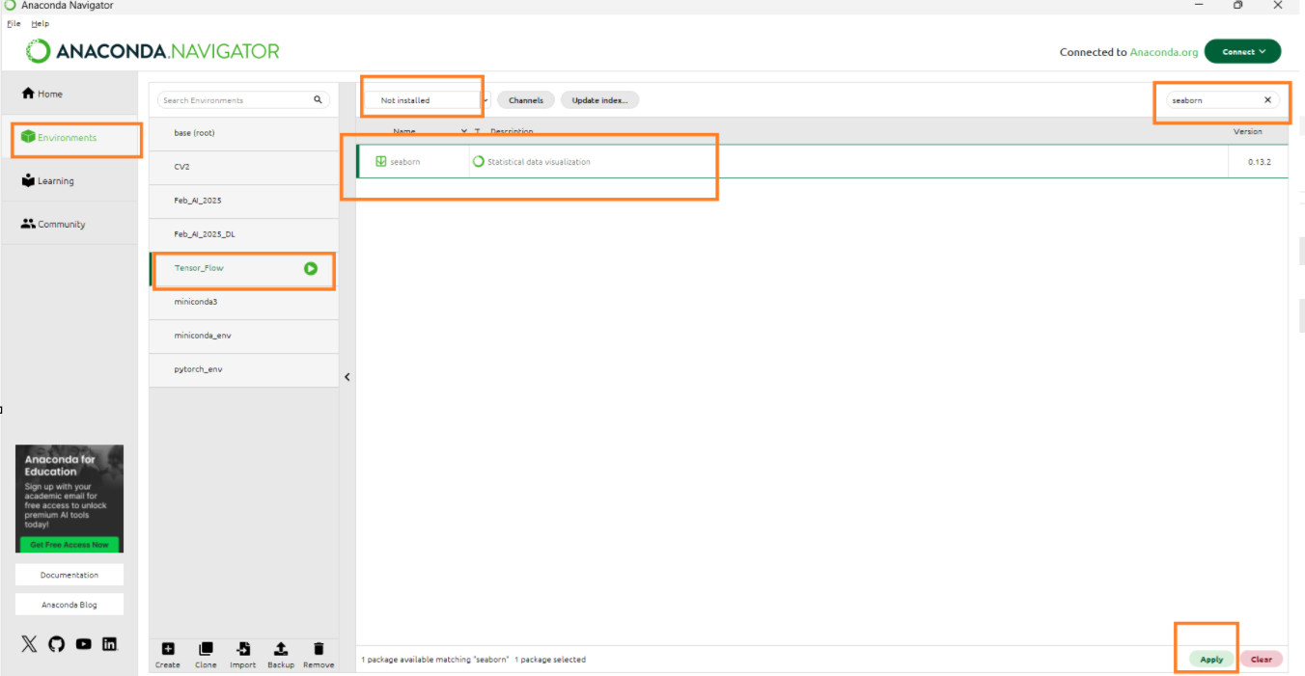
Install Common Libraries -Seaborn
Under Not Installed search Seaborn
Select Seaborn from the list click Apply

Slide 13
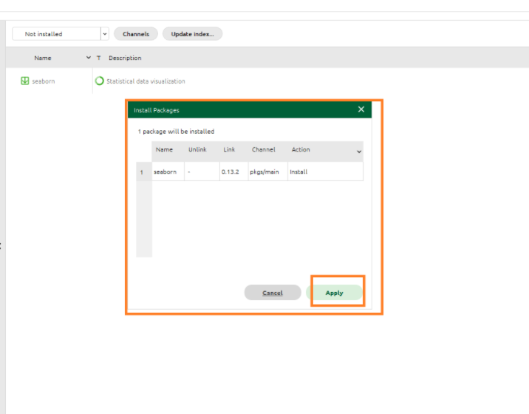
Install Common Libraries -Seaborn
Click Apply to install all packages

Slide 14
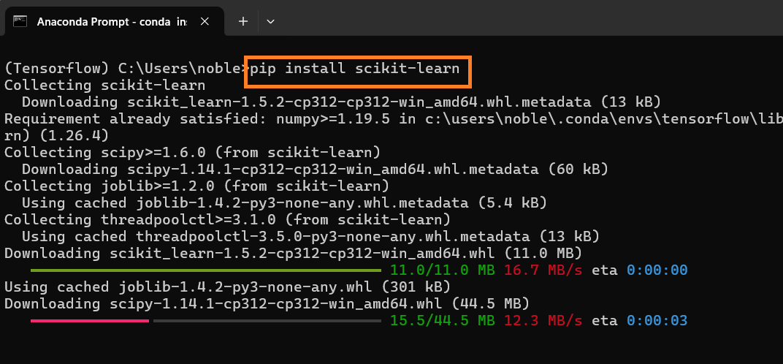
Install Common Libraries -scikit-learn
Install scikit-learn
pip install scikit-learn

Slide 15
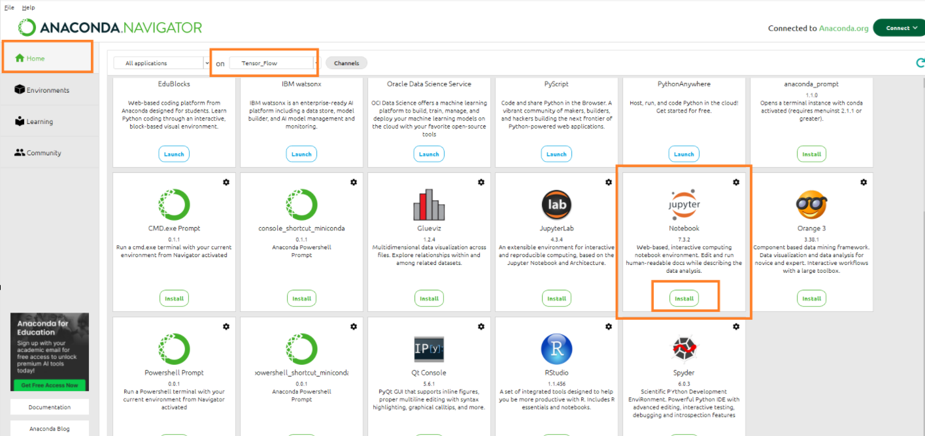
Install Jupyter Notebook
Click on Home
Select the newly created Tensor_flow environment from “Applications on”
Select Jupyter Notebook
Click Install

Slide 16
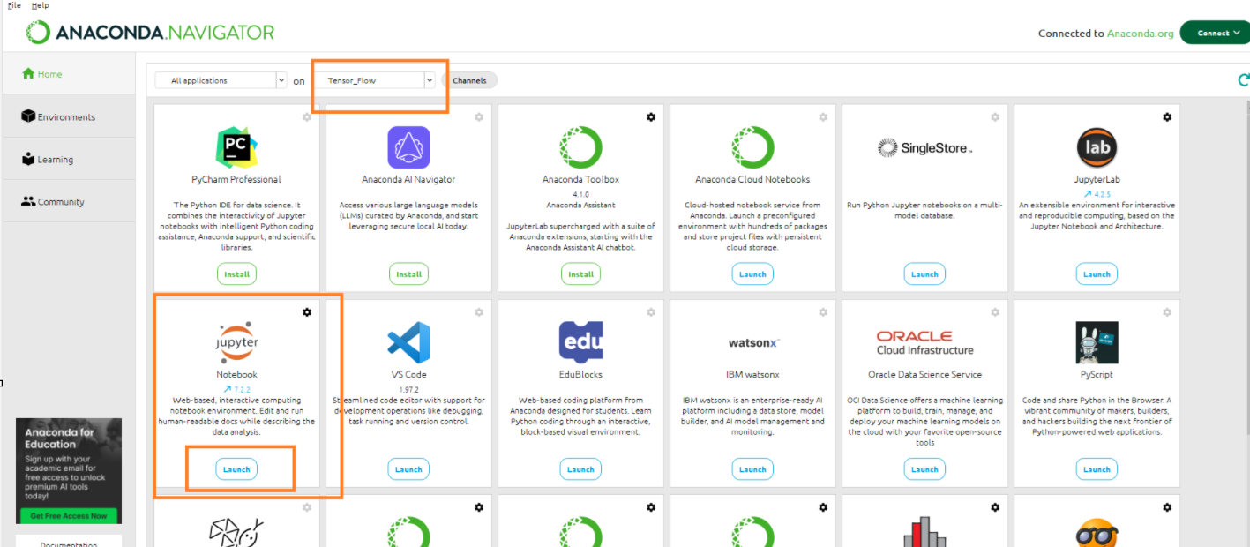
Launch Jupyter Notebook-Option1
Click on Home
Select the newly created Tensor_flow environment from “Applications on”
Select Jupyter Notebook
Click Launch

Slide 17
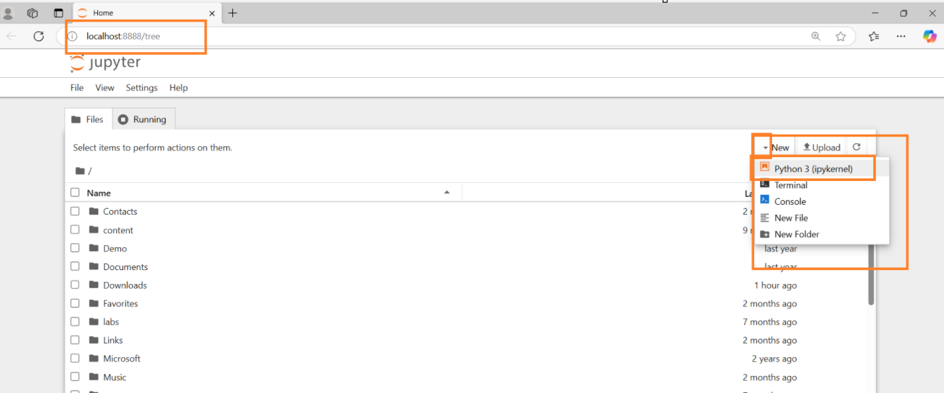
Launch Jupyter Notebook-Option1
Jupyter Notebook Launched in the Default Browser

Slide 18
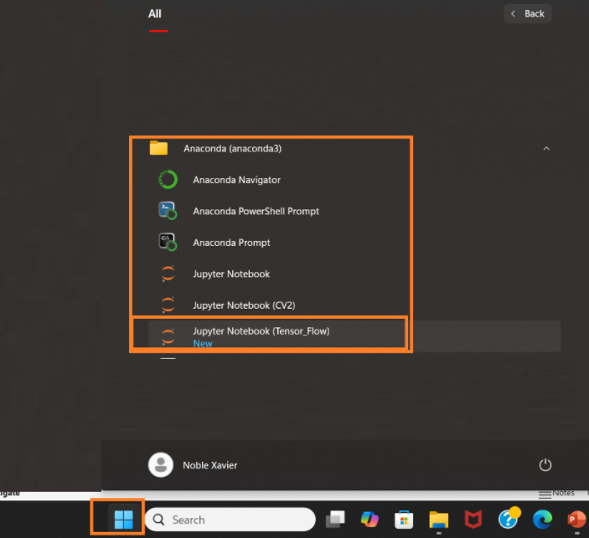
Launch Jupyter Notebook-Option2
Open Tensor Flow Jupyter Notebook
Start -> All -> Anaconda (anaconda3 ->
Jupyter Notebook (Tensor Flow)

Slide 19
Launch Jupyter Notebook-Option2
Jupyter Notebook Launched in the Default Browser

Slide 20
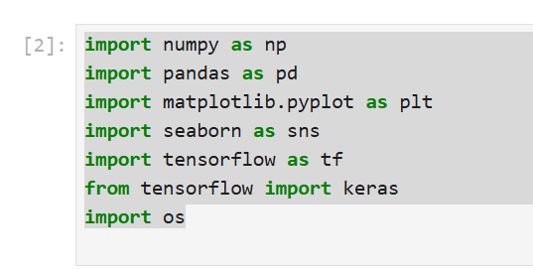
Launch Jupyter Notebook
Once it is open, check that Tensorflow , Keras and related libraries are working
import numpy as np
import pandas as pd
import matplotlib.pyplot as plt
import seaborn as sns
import tensorflow as tf
from tensorflow import keras
import os
The above commands need to be completed without any errors

